Slide 1
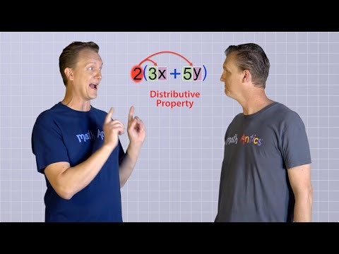
24
7
30
Algebra
Date
EQ – Describe how we use the distributive law to expand brackets
What is the distributive law?
he Distributive Law says that multiplying a number by a group of numbers added together is the same as doing each multiplication separately.
Example: 3 × (2 + 4) = 3×2 + 3×4
Notes:
Only watch the first half of the video (stop when it starts using indices)

Slide 2





24
7
30
Algebra
Date
EQ – Describe how we use the distributive law to expand brackets
How do I expand brackets?
Examples:
$3 \left(b+8\right)$ =
$10 \left(5 −x\right)=$
$6 \left(a+2a\right)=$
$$3b + 24$$
$$15 – 10x$$
$$6a+12a$$
$$=18a$$

Slide 3


Slide 4

Now it’s your Turn

Slide 5
MATCHING CARDS ACTIVITY ☺

